Slide 1
Above the Norm

Slide 2
The project is about on the world's largest taxi company Uber and Lyft

Slide 3
Machine Learning Workflow
01
04
Training and testing the model
Data
02
05
Data Preprocessing
Deploy the model
03
06
Feature Selection
Comparison of the Apps

Slide 4
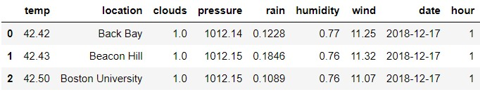
Weather
01
many obseravations of weather in the same location made in the same day but in different hours
Weather preprocessing
Rain
We used KNN Imptuer which is a distance-based imputation method to imputate rain values

Slide 5
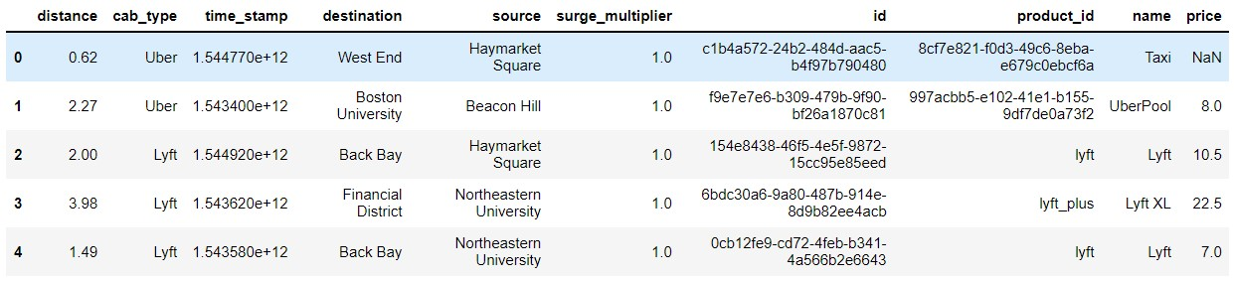
Data
distance - distance between two places in boston
cab_type - Uber or Lyft
time_stamp - time
destination
source
surge_multiplier - form of dynamic pricing in which the cost of a ride increases based on demand
id - a unique identifier for each trip
product_id - product id of car
name - name of uber car type

Slide 6
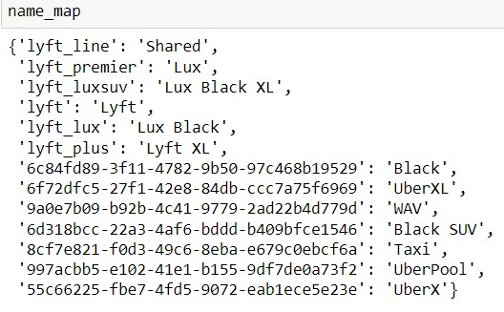
Data preprocessing
Time stamp
Source &dest
id
is coming as float64. Since timestamp indcates date so we can convert it into datetime
It will be dropped after merge
We dropped it after merge, low
Correlation and
Info incoded in distance
Prod_id&name
We maped product id to name based on count & removed product id as its info encoded in name

Slide 7
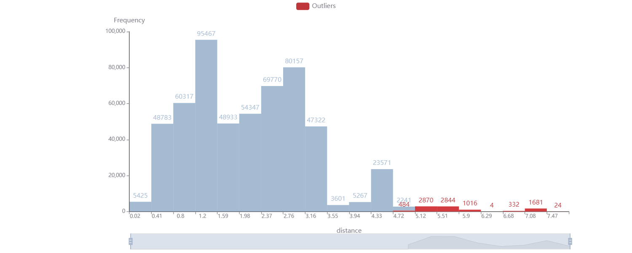
distance lies in the range of 0.02 to 7.86.
The average distance is 2.19, while the median of distance is 2.14.
9,255 outliers were found (96 unique outliers), which is 1.67% of the entire dataset (n=554,456). An outlier in the data occurs when distance >= 4.82. Caution
The distribution is skewed right (moderately).
Distance

Slide 8
Compared name to see how it relates to the price, we found strong correlation between them
UBER
LYFT
1- UberPool
2- Taxi
3- UberX
4- UberXL
5- WAV
6- black
7- Black SUV
we got the description from official company website
1- shared
2- lyft
3- lyft xl
4- lux
5- lux black
6- lux black xl
we got the description from official company website
Despite being red, Mars is a cold place full of iron oxide dust
Jupiter is a gas giant and the biggest planet in the Solar System
Mercury is the closest planet to the Sun and the smallest one

Slide 9
All taxi data had a price value null so we amputate It by help of uber website
We found that both taxi and uberx has the same price if we have the same distance and time.
Uber Ride Type Est. Ride Cost (4.6 miles, 18 minutes)
Pool $6-$10
taxi $9-$11
X $9-$12
Comfort $12-$16
XL $15-$20
Select $24-$30
WAV $30-$35
Black $30-$40
Black SUV $42-$52

Slide 10
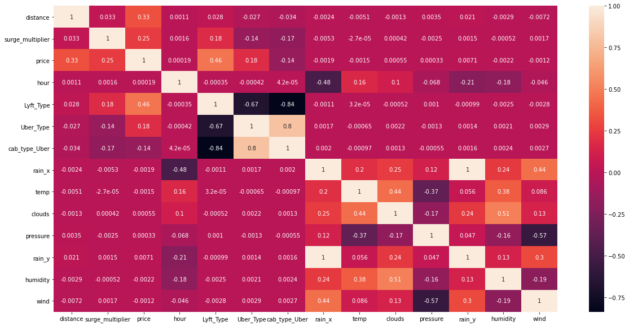
Feature Selection

Slide 11
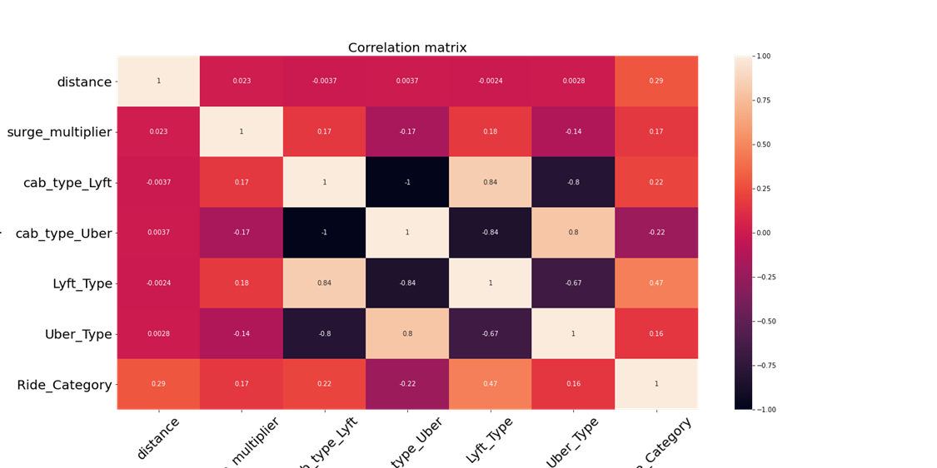
Feature Selection

Slide 12
Training and testing the model
For Multiple regression:
Mean Square Error 16.33271939415199
r2_score: 75.16022240596294 %
Training time: 0.10199832916259766 seconds
For Polynomial regression:
Degree : 4
Mean Square Error 3.203520780009517
r2_score: 95.94640692535074 %
Training time 0.12099742889404297 seconds

Slide 13





Deploy the Model
Tools:
1: Heroku Cloud Application Platform
2: Flask Framework
3: Android Studio:
4: Google Places API
5: Google Map API
6: Google Geocode by awesome Table

Slide 14
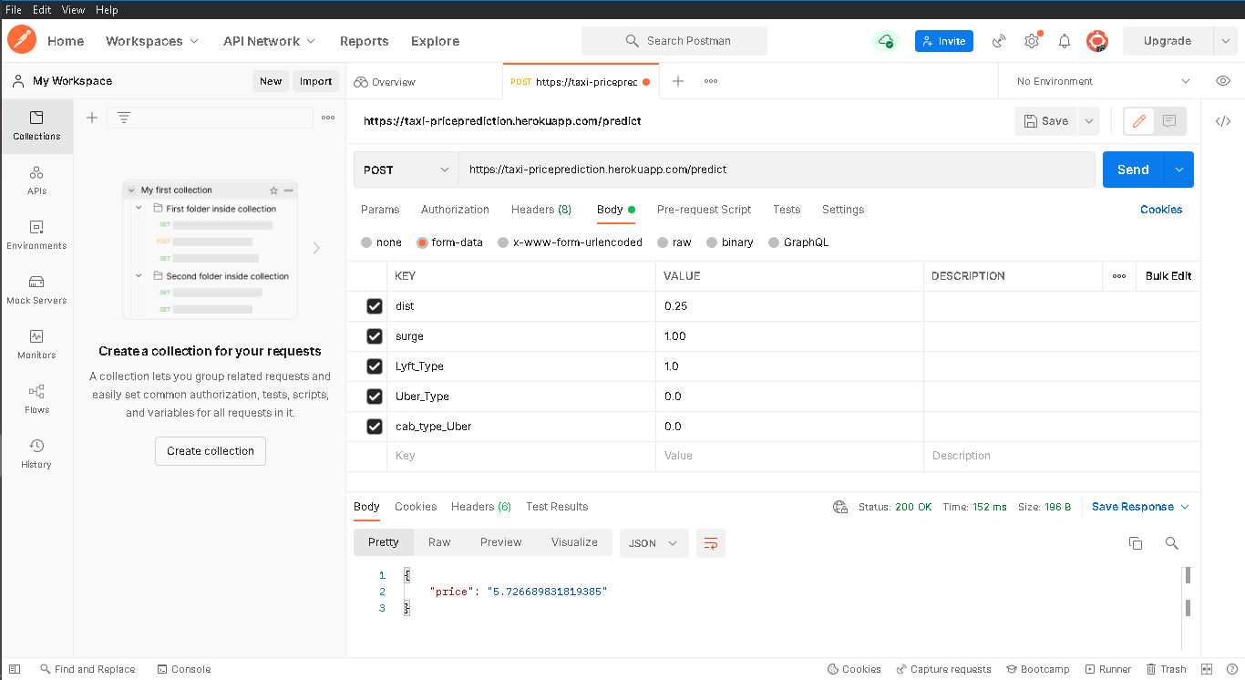
Post from Cloud host

Slide 15
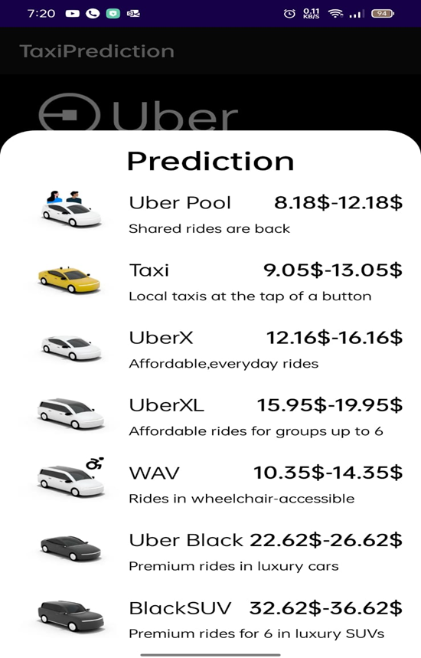
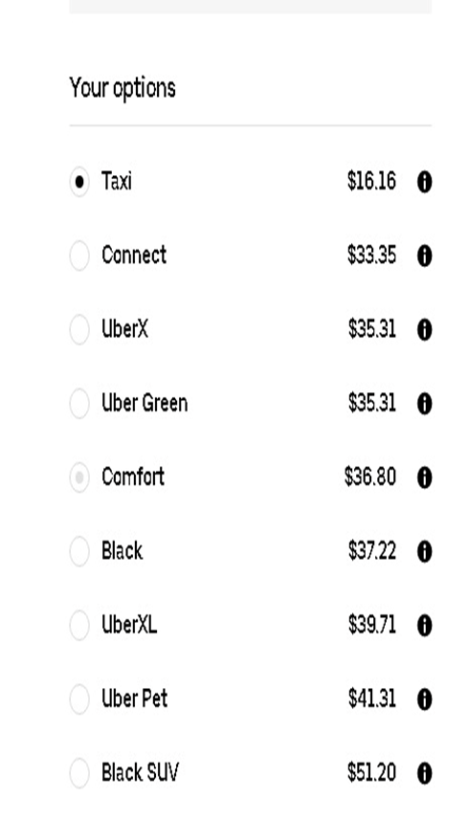
Comparison of the Apps
Our Uber APP
Real Uber APP

Slide 16
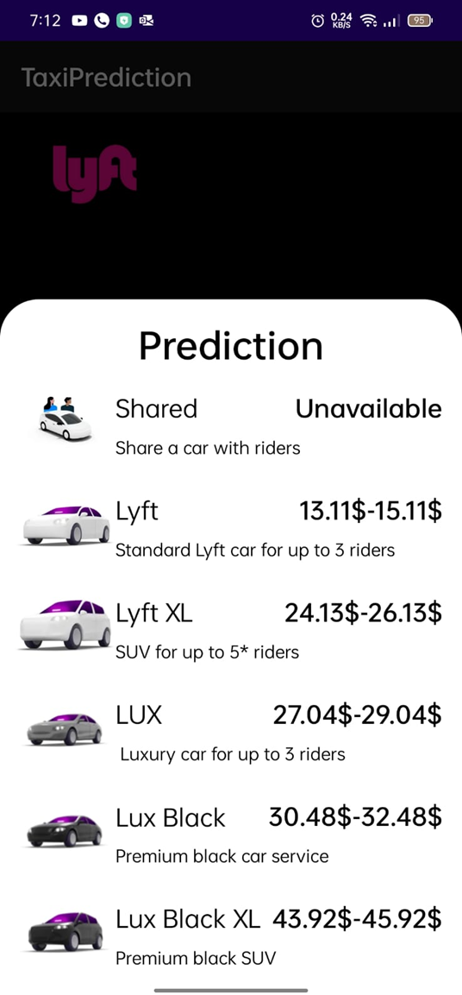
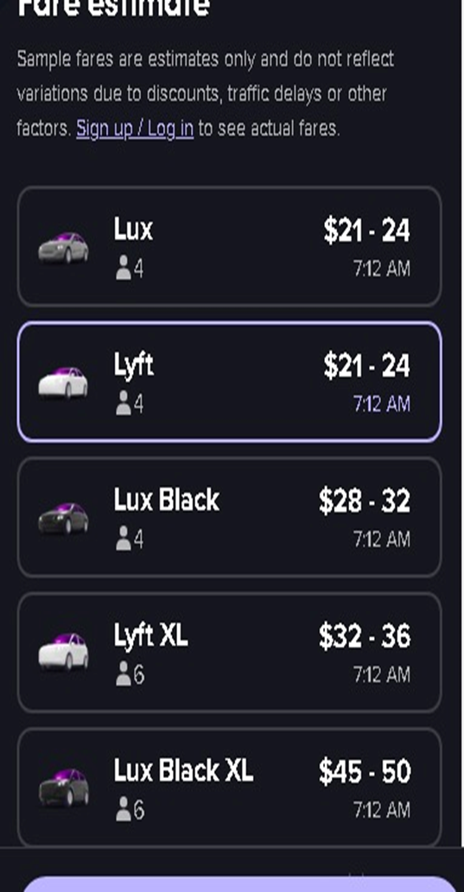
Comparison of the Apps
Our Lyft APP
Real Lyft APP

Slide 17

Demo

Slide 18


Slide 19
THANKS

